Slide 1
Pitch-Angle Scattering of Energetic Particles by Solar Wind Current Sheets
Understanding the Role of Coherent Structures in particle transport Zijin Zhang Anton V. Artemyev Vassilis Angelopoulos

Slide 2
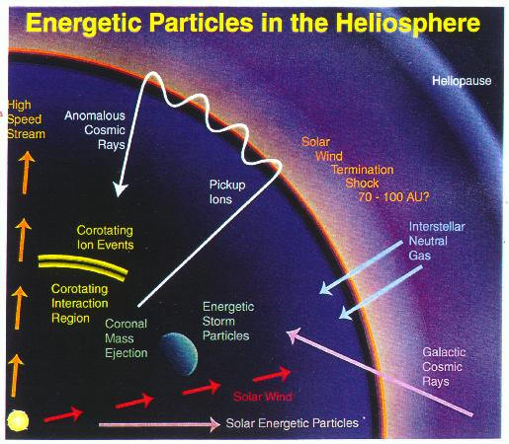
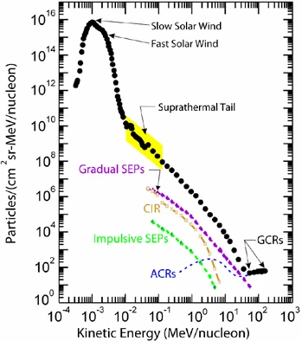
Introduction
Desai and Giacalone (2016)
Notes:
Notes: - Importance of energetic particle transport in astrophysical plasmas.
Solar energetic particles, or SEPs, from suprathermal (few keV) up to relativistic (∼few GeV) energies are accelerated near the Sun in at least two ways: (1) by magnetic reconnection-driven processes during solar flares resulting in impulsive SEPs, and (2) at fast coronal-mass-ejection-driven shock waves that produce large gradual SEP events. Large gradual SEP events are of particular interest because the accompanying high-energy (>10s MeV) protons pose serious radiation threats to human explorers living and working beyond low-Earth orbit and to technological assets such as communications and scientific satellites in space. However, a complete understanding of these large SEP events has eluded us primarily because their properties, as observed in Earth orbit, are smeared due to mixing and contributions from many important physical effects.

Slide 3
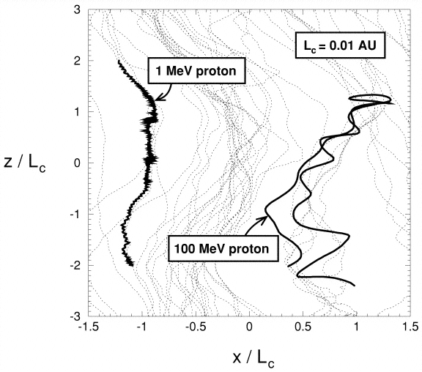
Introduction - Particle Transport in Turbulent Magnetic Field
Parallel diffusion due to pitch-angle diffusion
Drift motion due to magnetic field inhomogeneities
Transverse diffusion due to random walk of magnetic lines
Sample particle trajectories of two protons superimposed on magnetic field lines.
Giacalone and Jokipii (1999)
Notes:
Notes: - Role of turbulent magnetic fields in the heliosphere.
Pitch-angle diffusion, connected with transport in the direction parallel to magnetic field, drift motions due to magnetic field inhomogeneities, as well as transverse diffusion due to random walk of magnetic lines are all aspects of energetic particle transport that are controlled by magnetic turbulence properties, such as fluctuation amplitude, spectral index and anisotropy.

Slide 4
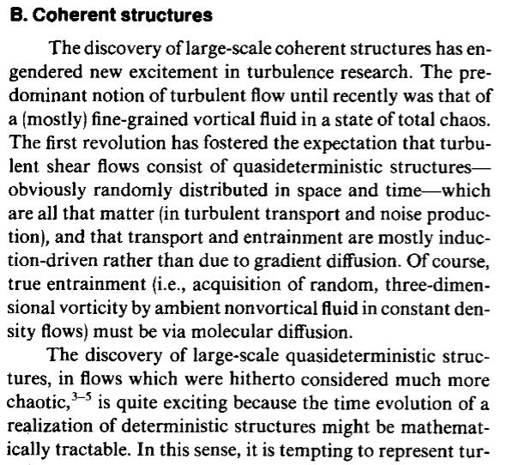
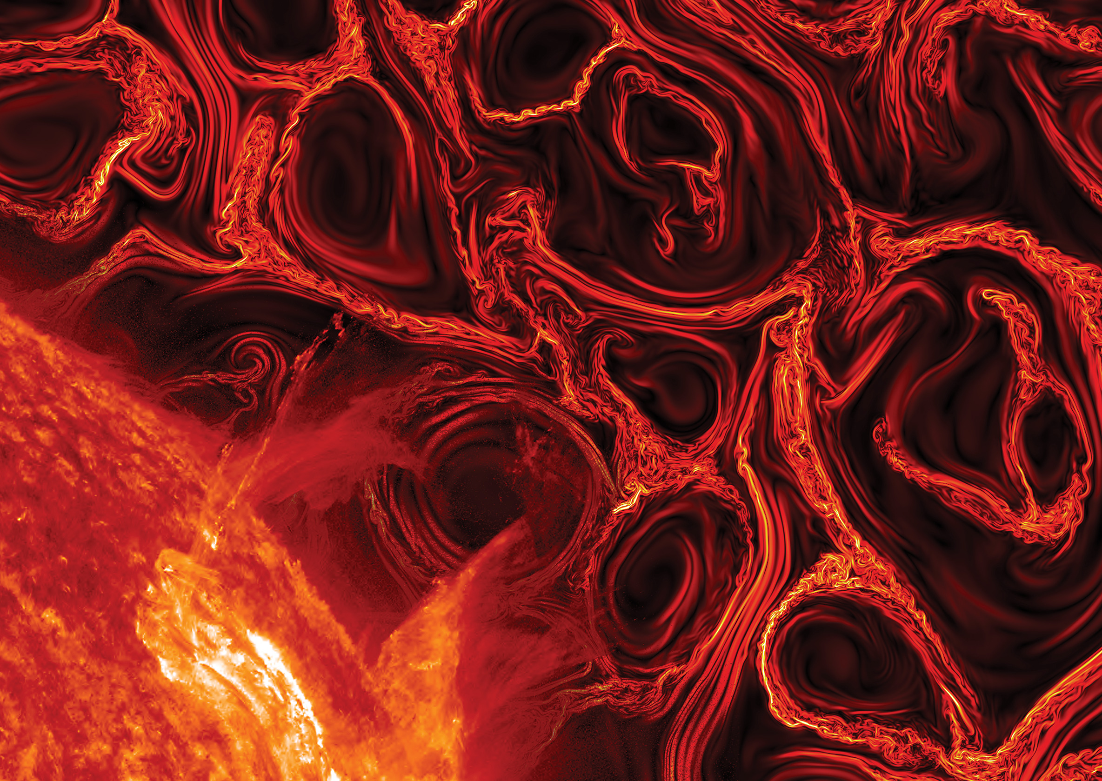
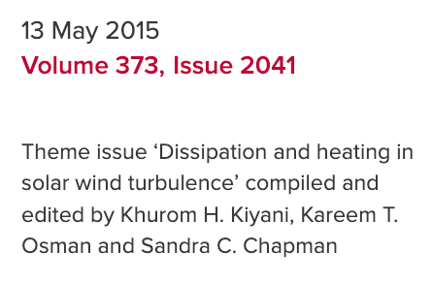
Introduction - Turbulence and Coherent Structures
Hussain (1983)
Cover image: A direct numerical simulation of MHD turbulence in the presence of a strong guide field.
Development of strong current sheets and instabilities in the current density, in one of the planes perpendicular to the guide field.
Turbulence should not be regarded merely as a collection of random fluctuations.
Instead, the nonlinear energy cascade process results in the formation of coherent structures.
Notes:
Notes: - Emphasize that coherent structures have distinct, observable features. - Describe how these structures can dominate scattering processes.
The classical theory of ion scattering is based on consideration of an ensemble of random magnetic field fluctuations [7,8,15], whereas the internal structure of such fluctuations has not been studied in detail.

Slide 5
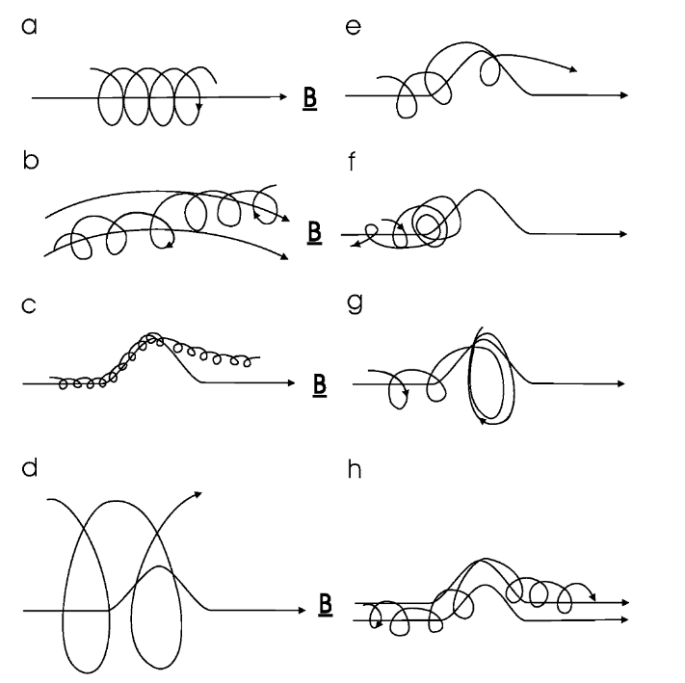
Introduction - Particle Motion in Magnetic Field
In a uniform magnetic field the particle
Non-uniform: gradient and curvature drifts
When a particle meets a kink that has a scale length >> rg , all particles will progress through the kink
rg scale >> size of the kink, all particles will pass through it without being affected much.
(e, f, g, h) When rg ≈ scale size of the kink
Moraal (2013)
Notes:
Fig. 1 Charged particle motion in a magnetic field. (a) In a uniform magnetic field the particle has a spiral orbit with a gyroradius rg = P /Bc. (b) When the field is non-uniform the particle drifts away from a field line due to the gradient and curvature of the field. (c) When a particle meets a kink in the field that has a scale length rg , all particles will progress through the kink (but they may drift to adjacent field lines while doing so). (d) Likewise, if rg scale size of the kink, all particles will pass through it without being affected much. (e, f, g) When rg ≈ scale size of the kink, it depends on the gyrophase of the motion when the particles starts to feel the kink whether it will go through the kink (e), be reflected back (f), or effectively get stuck in the kink (g). This process is called pitch-angle scattering along the field. (h) When particles meet such a kink, there is also a scattering in phase angle, which leads to scattering across the field lines, but such that κ⊥ κ‖

Slide 6
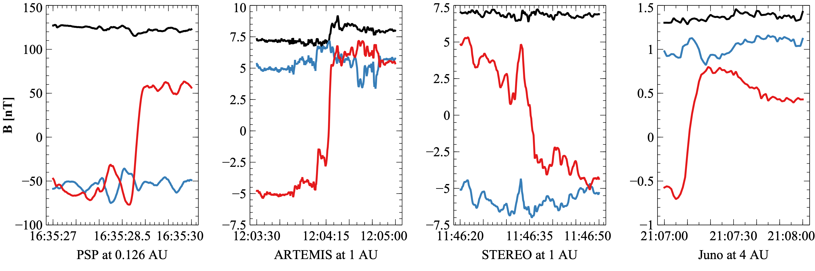

Introduction - Current Sheets in the Solar Wind
Current sheets detected by PSP, Juno, STEREO and near-Earth ARTEMIS satellite: red, blue, and black lines are $B_{l}$, $B_{m}$, and |B|.

Slide 7
The Problem: Scattering by Current Sheets
Malara et al. (2023), Malara, Perri, and Zimbardo (2021)
Artemyev et al. (2020) , Artemyev, Neishtadt, and Zelenyi (2013a, 2013b)
Zelenyi et al. (2013), Neishtadt (2000)
Büchner and Zelenyi (1989), ), Chen (1986), Tennyson et al (1986)
Motivation / Gap : Prior studies lack realistic solar wind statistics &/ large-scale simulation in a realistic magnetic field
How can we quantify the efficiency of ion scattering by solar wind discontinuities?
Notes:
Image: Schematic of a particle trajectory interacting with a current sheet. Notes: - Why current sheets matter: Non-diffusive scattering, chaotic dynamics. - Gap: Prior studies lack realistic solar wind statistics.

Slide 8
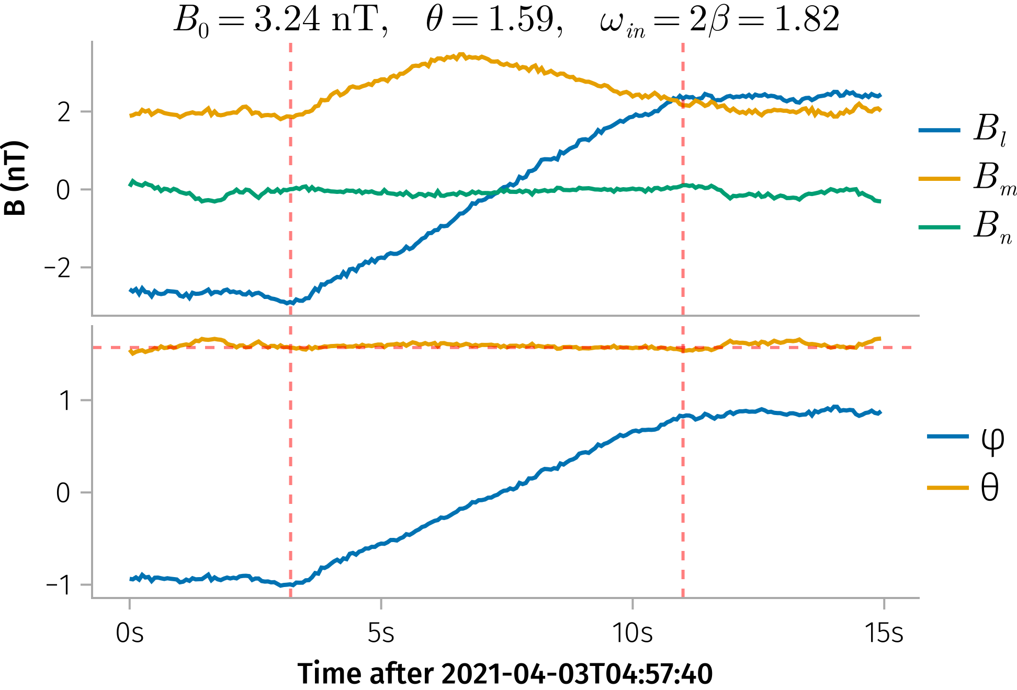
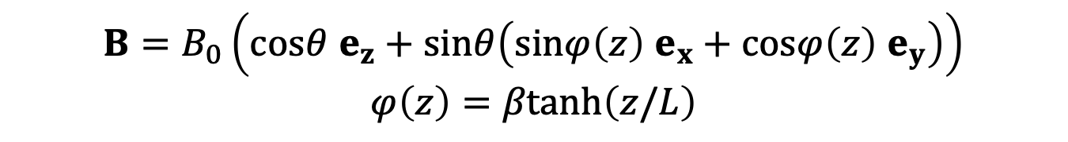
Analytical Model - Magnetic Field Model
Example of a current sheet observed by ARTEMIS.
$$B=B_{0}\left(cosθ e_{z}+sinθ\left(sinφ\left(z\right) e_{x}+cosφ\left(z\right) e_{y}\right)\right)$$
$$φ\left(z\right)=βtanh\left(z/L\right)$$

Slide 9
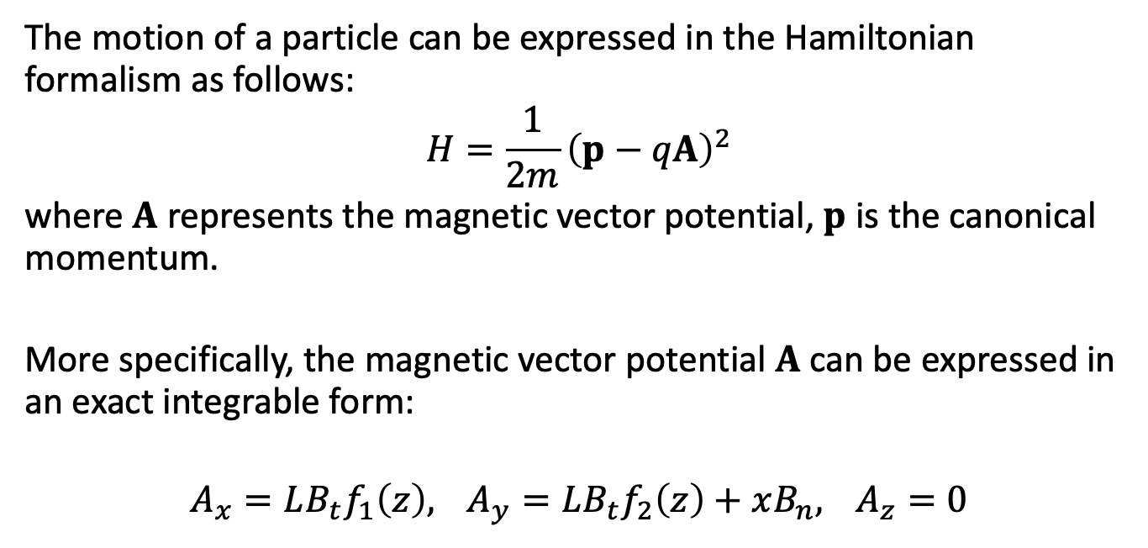
Analytical Model - Hamiltonian Approach
The motion of a particle can be expressed in the Hamiltonian formalism as follows:
$$H=\frac{1}{2m}{\left(p−qA\right)}^{2}$$
where $A$ represents the magnetic vector potential, $p$ is the canonical momentum.
More specifically, the magnetic vector potential $A$ can be expressed in an exact integrable form:
$$A_{x}=LB_{t}f_{1}\left(z\right), A_{y}=LB_{t}f_{2}\left(z\right)+xB_{n}, A_{z}=0$$
Notes:
Key Points:
Introduction to the Hamiltonian formalism in this context.
Expression for the magnetic vector potential.
Transition from canonical to dimensionless variables.
Notes:
Explain why the Hamiltonian approach is useful for modeling particle dynamics.
Highlight the derivation steps and the significance of the normalization.
Image Suggestion:
Flow diagram summarizing the derivation from the physical Hamiltonian to the dimensionless form.

Slide 10


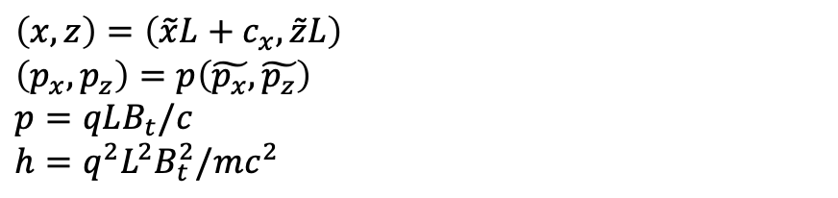

Analytical Model - Dimensionless Hamiltonian and Asymptotic Expansion
$$\left(x,z\right)=\left(\tilde{x}L+c_{x},\tilde{z}L\right)$$
$\left(p_{x},p_{z}\right)=p\left(\tilde{p_{x}},\tilde{p_{z}}\right)$ $$p=qLB_{t}/c$$
$$h=q^{2}L^{2}B_{t}^{2}/mc^{2}$$
$$\tilde{H}=\frac{1}{2}\left({\left(\tilde{p_{x}}−f_{1}\left(\tilde{z}\right)\right)}^{2}+{\left(\tilde{x}cotθ+f_{2}\left(\tilde{z}\right)\right)}^{2}+{\tilde{p_{z}}}^{2}\right)$$
$$\begin{matrix} & f_{1}\left(\tilde{z}\right)=\frac{1}{2}cosβ \left(\text{Ci}\left(βs_{+}\left(\tilde{z}\right)\right)−\text{Ci}\left(βs_{−}\left(\tilde{z}\right)\right)\right) \\ & +\frac{1}{2}sinβ \left(\text{Si}\left(βs_{+}\left(\tilde{z}\right)\right)−\text{Si}\left(βs_{−}\left(z\right)\right)\right), \\ & f_{2}\left(\tilde{z}\right)=\frac{1}{2}sinβ \left(\text{Ci}\left(βs_{+}\left(\tilde{z}\right)\right)+\text{Ci}\left(βs_{−}\left(\tilde{z}\right)\right)\right) \\ & −\frac{1}{2}cosβ \left(\text{Si}\left(βs_{+}\left(\tilde{z}\right)\right)+\text{Si}\left(βs_{−}\left(\tilde{z}\right)\right)\right)\end{matrix}$$
$$κ=cotθ$$
$$f_{1}\left(z\right) \sim z−\frac{1}{6}β^{2}z^{3}+O\left(z^{4}\right)$$
$$f_{2}\left(z\right) \sim \frac{βz^{2}}{2}+O\left(z^{4}\right)$$

Slide 11
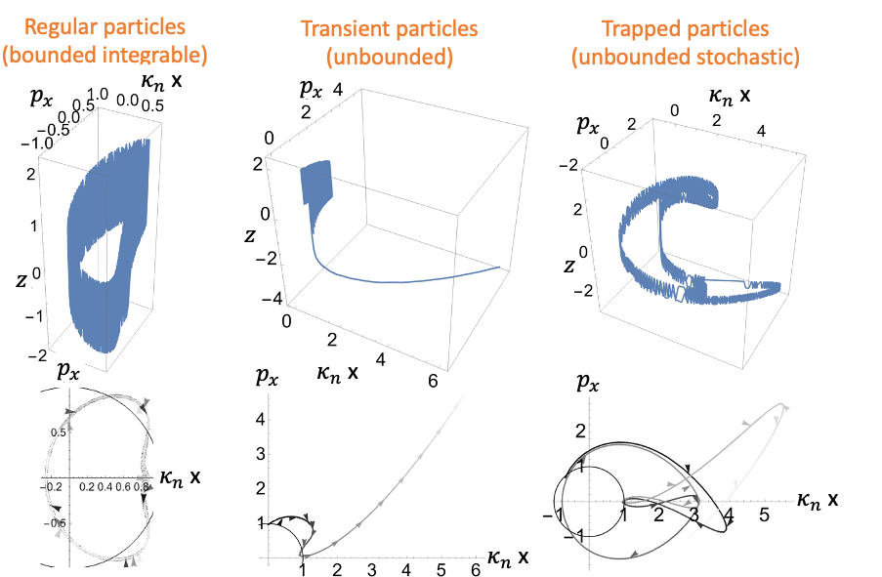
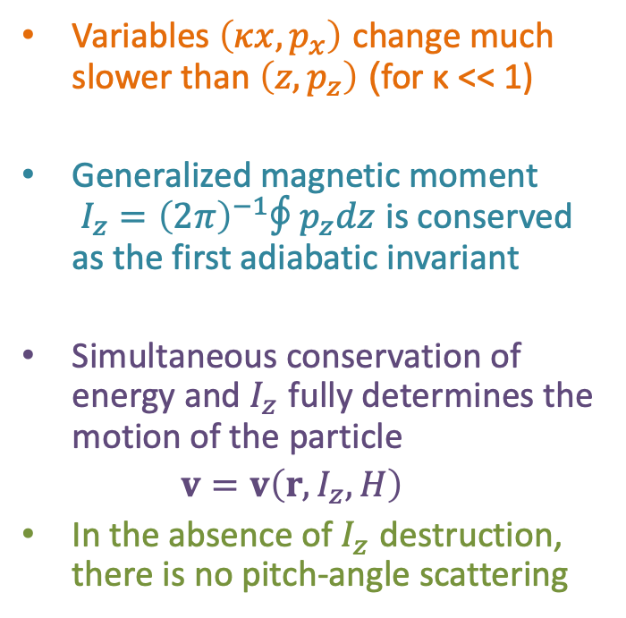
Adiabatic Invariance and Pitch Angle
Variables $\left(κx,p_{x}\right)$ change much slower than $\left(z,p_{z}\right)$ (for κ << 1)
Generalized magnetic moment $I_{z}={\left(2π\right)}^{−1}∮p_{z}dz$ is conserved as the first adiabatic invariant
Simultaneous conservation of energy and $I_{z}$ fully determines the motion of the particle
$v=v\left(r,I_{z},H\right)$
In the absence of $I_{z}$ destruction, there is no pitch-angle scattering
Particle trajectories in phase space
Notes:
Key Points:
Definition of adiabatic invariance and the magnetic moment (I_z).
Conditions under which the adiabatic invariant is conserved.
Notes:
Explain the concept of adiabatic invariance in simple terms.
Discuss why maintaining (I_z) is important for particle trajectory predictions.
Image Suggestion:
Diagram depicting adiabatic invariance with trajectories in phase space.

Slide 12
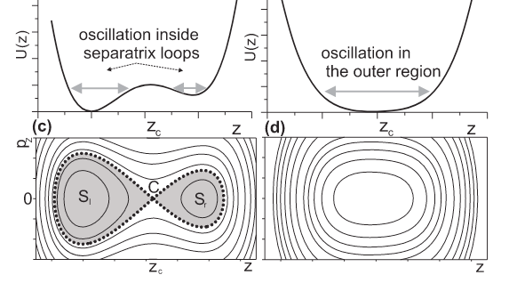
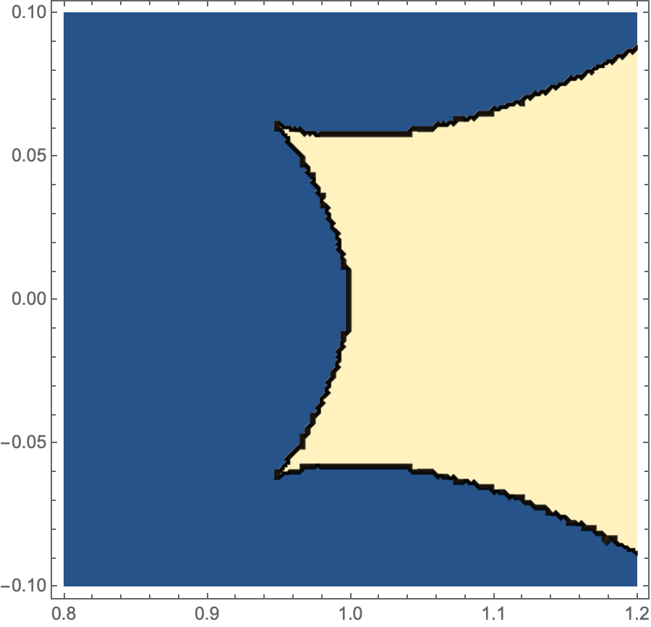
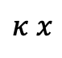
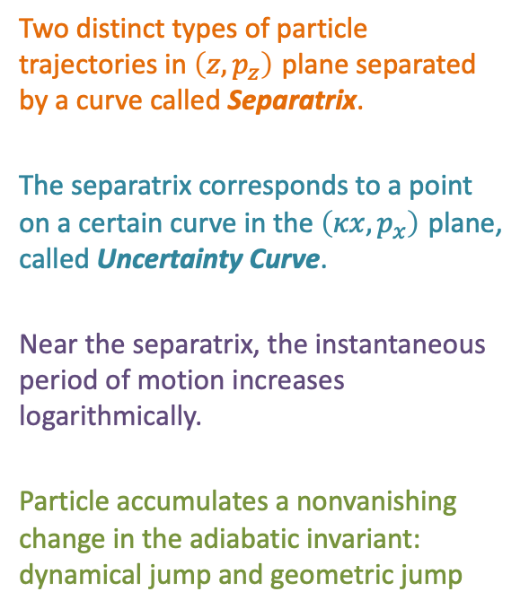
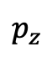
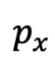
Destruction of Adiabatic Invariance: Separatrix and Uncertainty Curve
Two distinct types of particle trajectories in $\left(z,p_{z}\right)$ plane separated by a curve called Separatrix.
The separatrix corresponds to a point on a certain curve in the $\left(κx,p_{x}\right)$ plane, called Uncertainty Curve.
Near the separatrix, the instantaneous period of motion increases logarithmically.
Particle accumulates a nonvanishing change in the adiabatic invariant: dynamical jump and geometric jump
$$p_{z}$$
One solution
$$p_{x}$$
Uncertainty curve
Two solution
$$κ x$$

Slide 13
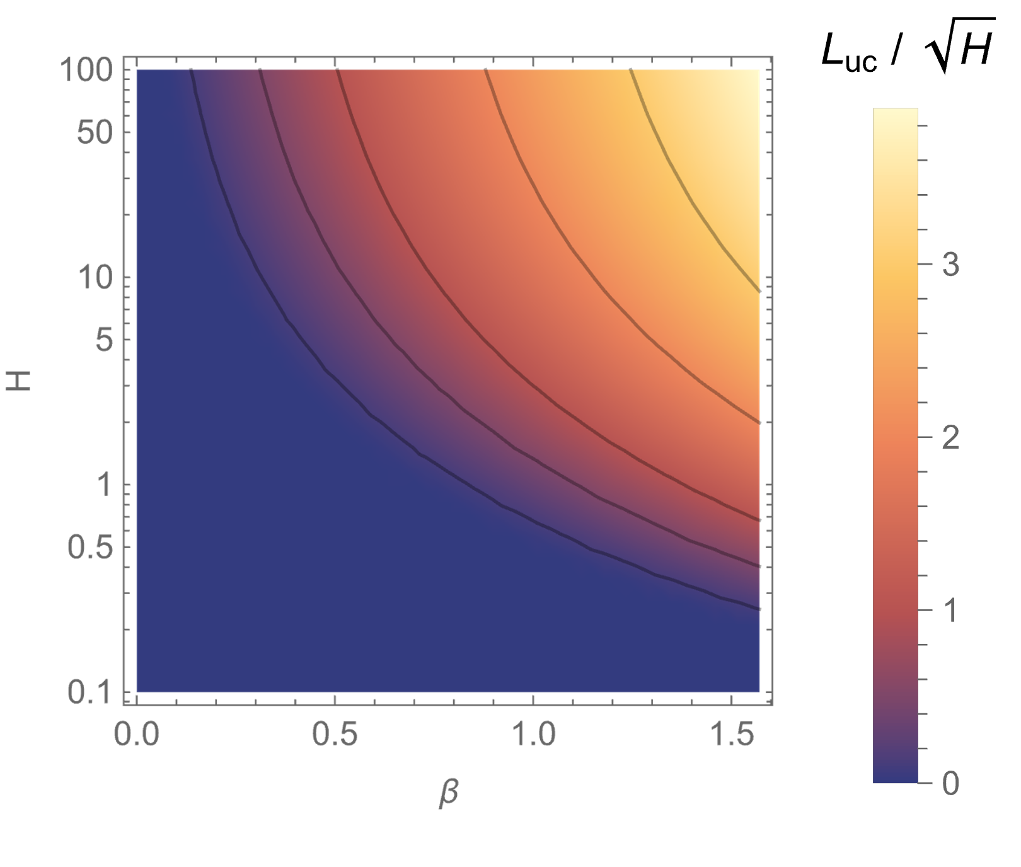
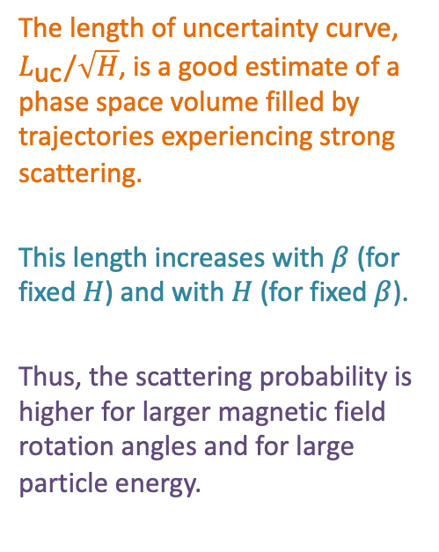

Uncertainty curve
The length of uncertainty curve, $L_{\text{uc}}/\sqrt{H}$, is a good estimate of a phase space volume filled by trajectories experiencing strong scattering.
This length increases with $β$ (for fixed $H$) and with $H$ (for fixed $β$).
Thus, the scattering probability is higher for larger magnetic field rotation angles and for large particle energy.
The uncertainty curve length $L_{\text{uc}}/\sqrt{H}$ as a function of $β$ and normalized particle energy $H$.

Slide 14
Part 2
In the first part, we introduced the basic physics of ion scattering by the solar wind.
Takeaway 1: Larger magnetic field rotation angles and higher particle energies lead to larger chance of pitch-angle scattering.
In the following part, we will focus on the test particle simulations to quantify the ion scattering by the solar wind current sheets.

Slide 15
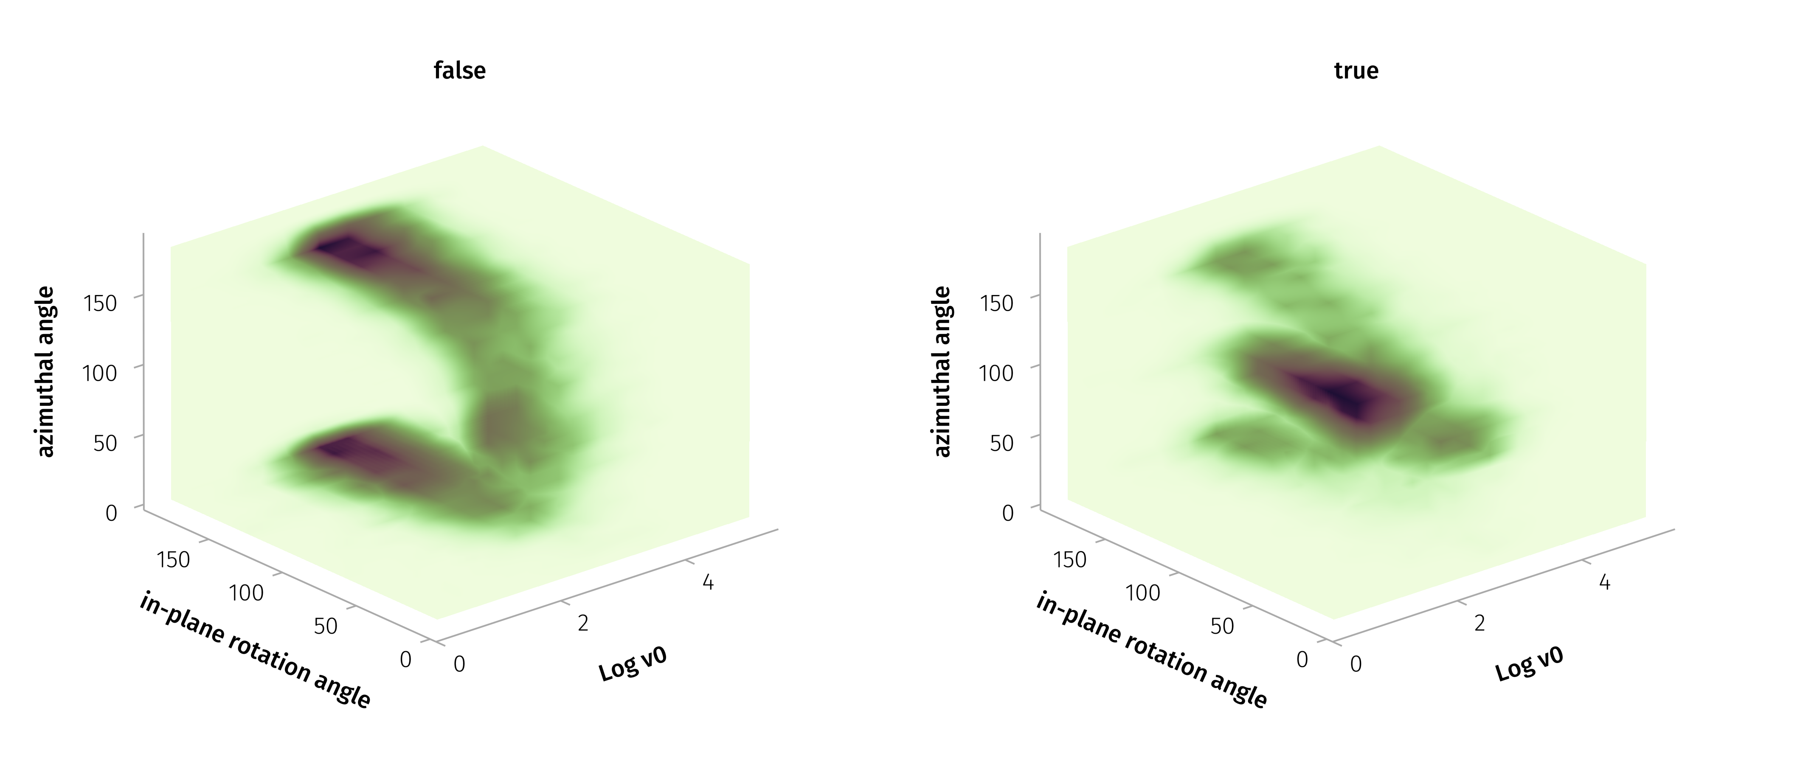
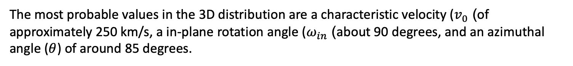

Test Particle Simulations - Solar Wind Dataset
$Δ\left|B\right|/\left|B\right|>0.05$ or $ω>60°$ (Liu et al. 2023)
The most probable values in the 3D distribution are a characteristic velocity ($v_{0}$) of approximately 250 km/s, a in-plane rotation angle ($ω_{in}$) about 90 degrees, and an azimuthal angle ($θ$) of around 85 degrees.

Slide 16
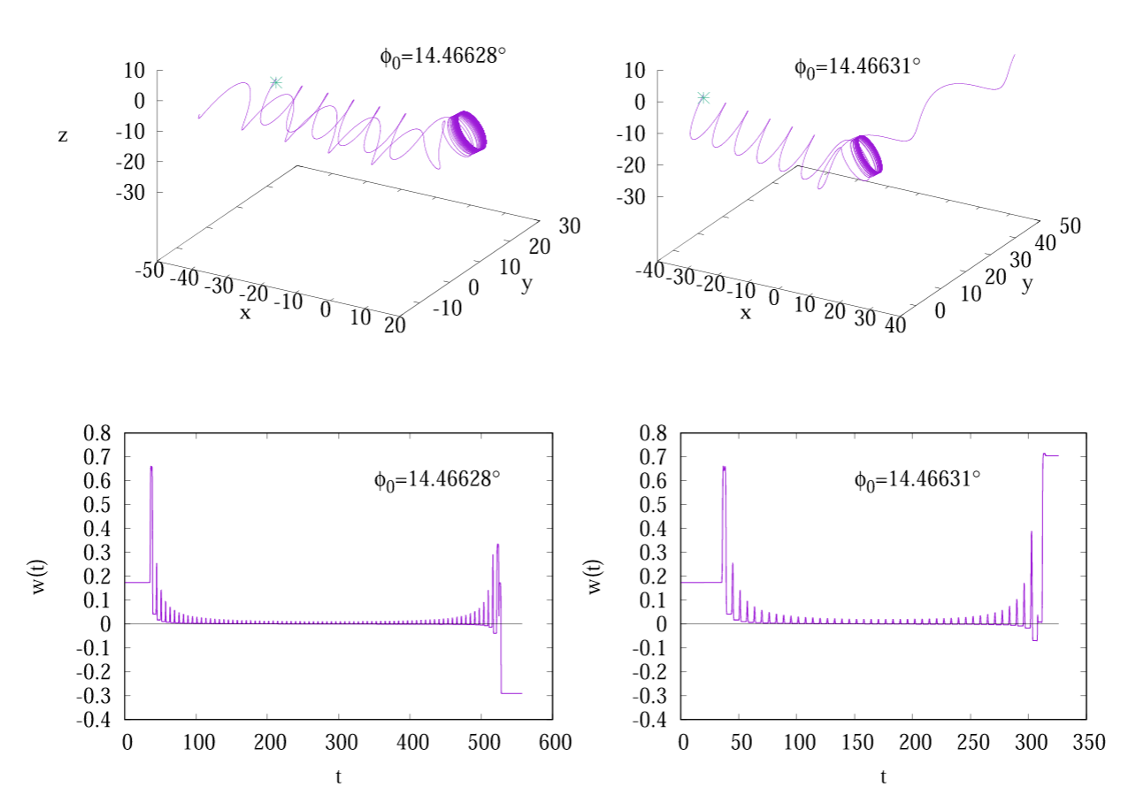
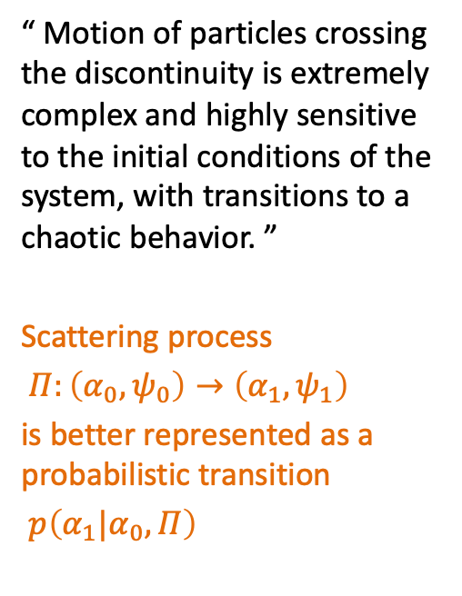

Examples of Pitch Angle Scattering
“ Motion of particles crossing the discontinuity is extremely complex and highly sensitive to the initial conditions of the system, with transitions to a chaotic behavior. ”
Scattering process
$Π:\left(α_{0},ψ_{0}\right)→\left(α_{1},ψ_{1}\right)$
is better represented as a probabilistic transition
$p\left(α_{1}|α_{0},Π\right)$
$$cos α(t)$$
The trajectories of two particles starting with two slightly different gyrophases
Malara, Perri, and Zimbardo (2021)

Slide 17
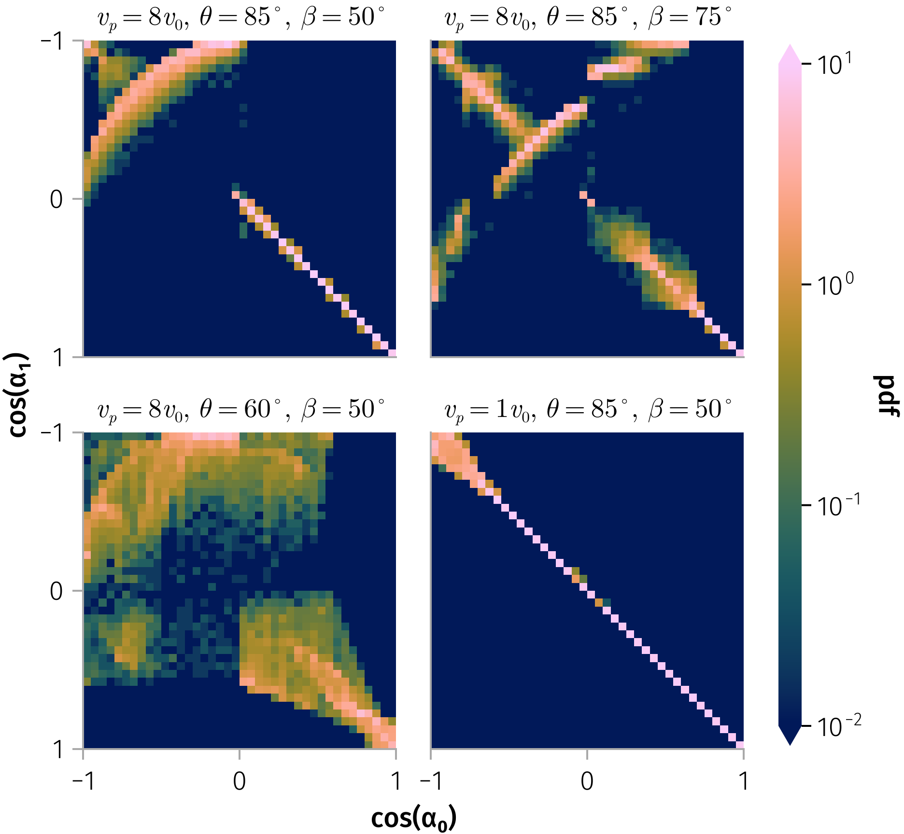
Transition Matrix
Transition matrix for 100 keV protons under four distinct magnetic field configurations
Notes:
Long-term modeling of particle pitch-angle distributions resulting from current-sheet scattering involves simulating the dynamics of a large number of particles through multiple current-sheet interactions over extended periods. To reduce computational time and complexity, we derive a simplified probabilistic description of pitch-angle evolution for modeling energetic particle transport under current-sheet scattering.
The scattering process depends on the particle's initial conditions, $(\mathbf{r}, \mathbf{v})$, as well as the configuration of the current sheet, $\mathbf{B}$.

Slide 18
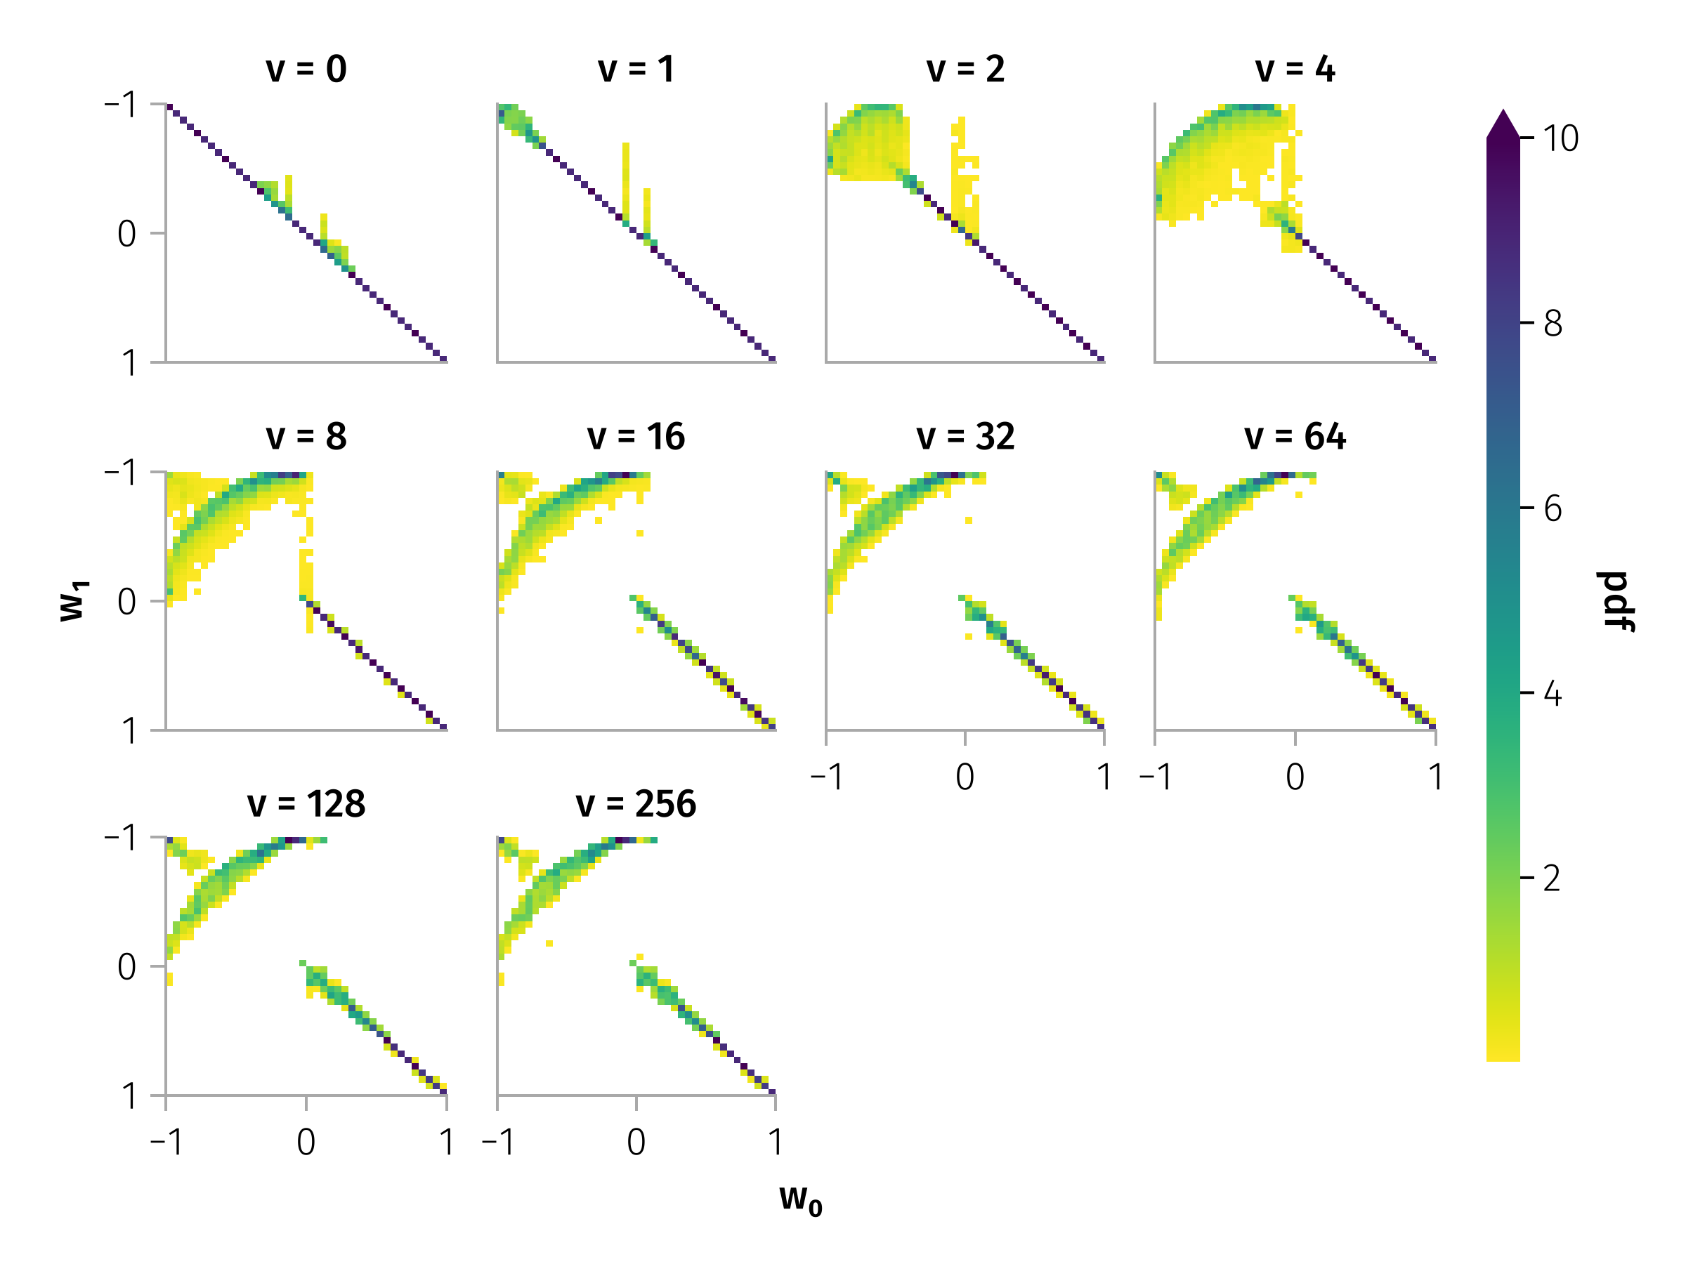

Pitch angle scattering by typical discontinuity
With in-plane rotation angle ($ω_{in}$) about 90 degrees, and azimuthal angle ($θ$) of around 85 degrees.
Luckily, higher or lower energy do not exhibit apparently different scattering probabilities.

Slide 19
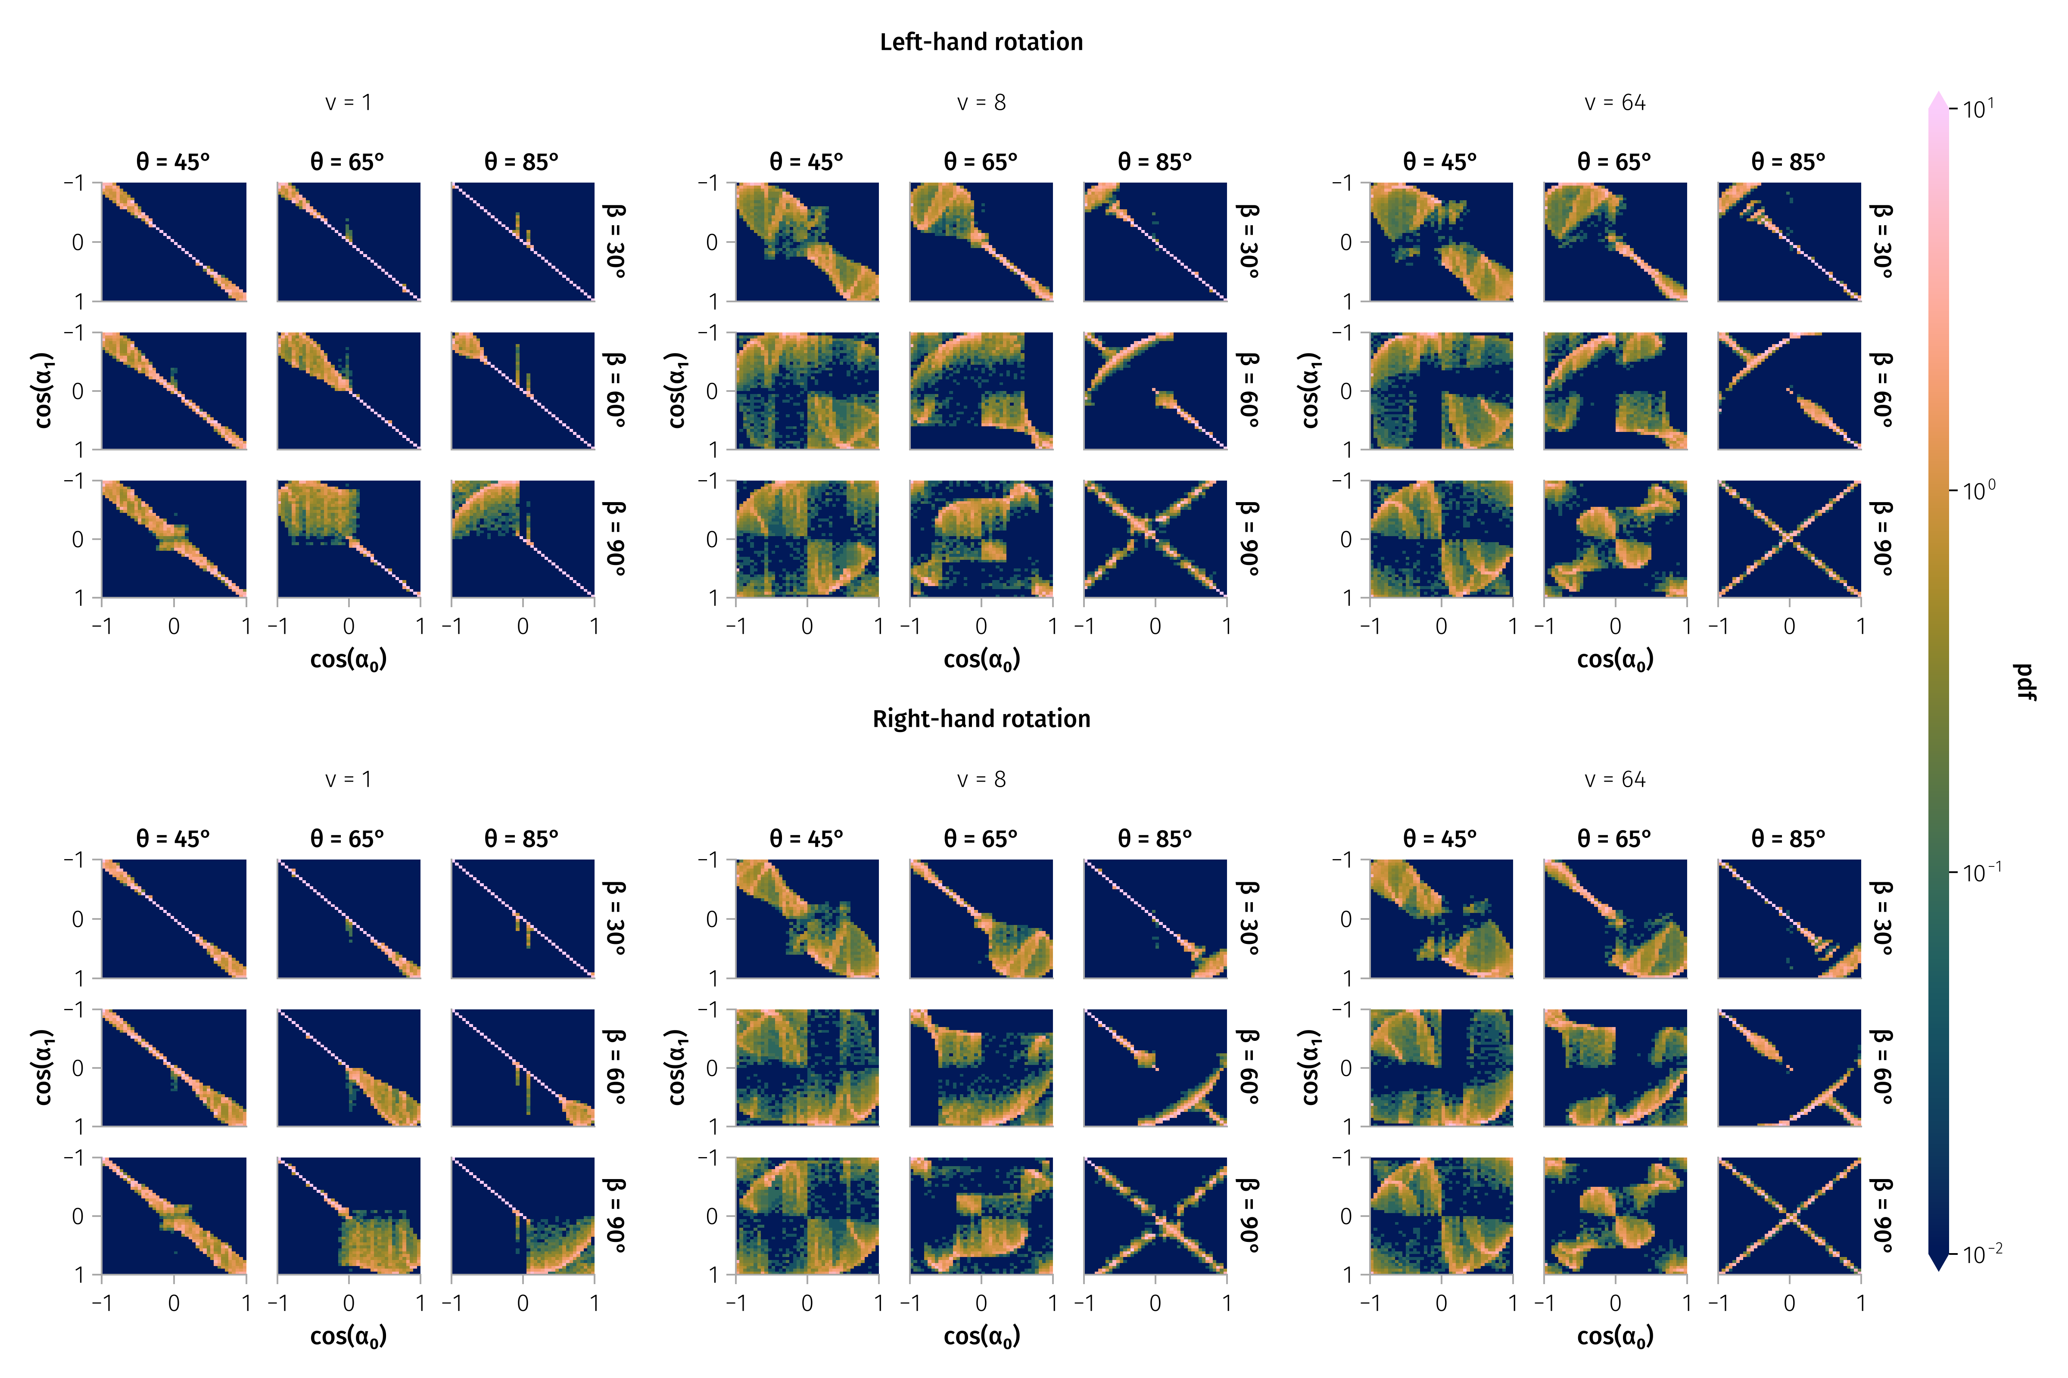
Transition Matrix

Slide 20
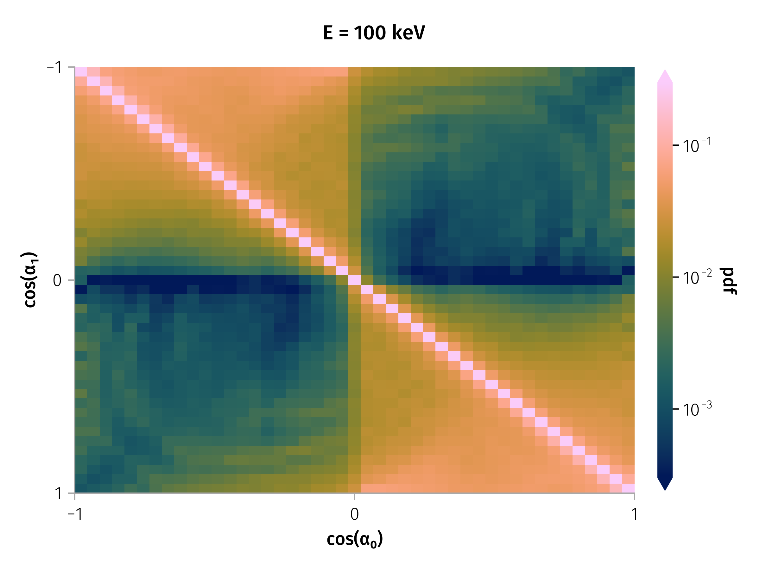
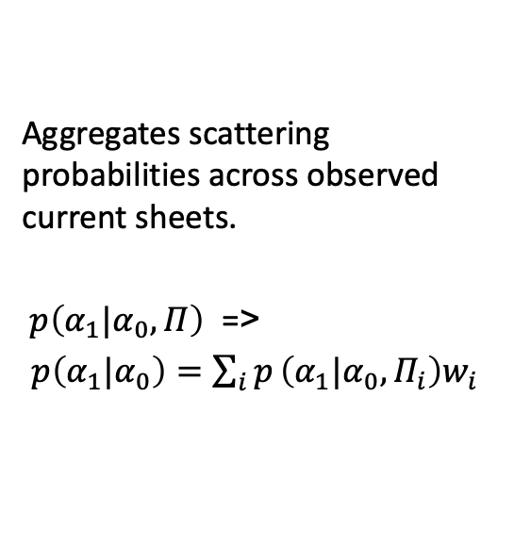
Weighted Transition Matrix
Aggregates scattering probabilities across observed current sheets.
$p\left(α_{1}|α_{0},Π\right)$ =>
$p\left(α_{1}|α_{0}\right)=\sum_{i}^{​}{p}\left(α_{1}|α_{0},Π_{i}\right)w_{i}$
Transition matrix for 100 keV particles.
Notes:
Image: WTM heatmap from fig-tm-stats-100keV. Notes: - Aggregates scattering probabilities across observed current sheets. - Bright diagonal = most particles weakly scattered.

Slide 21
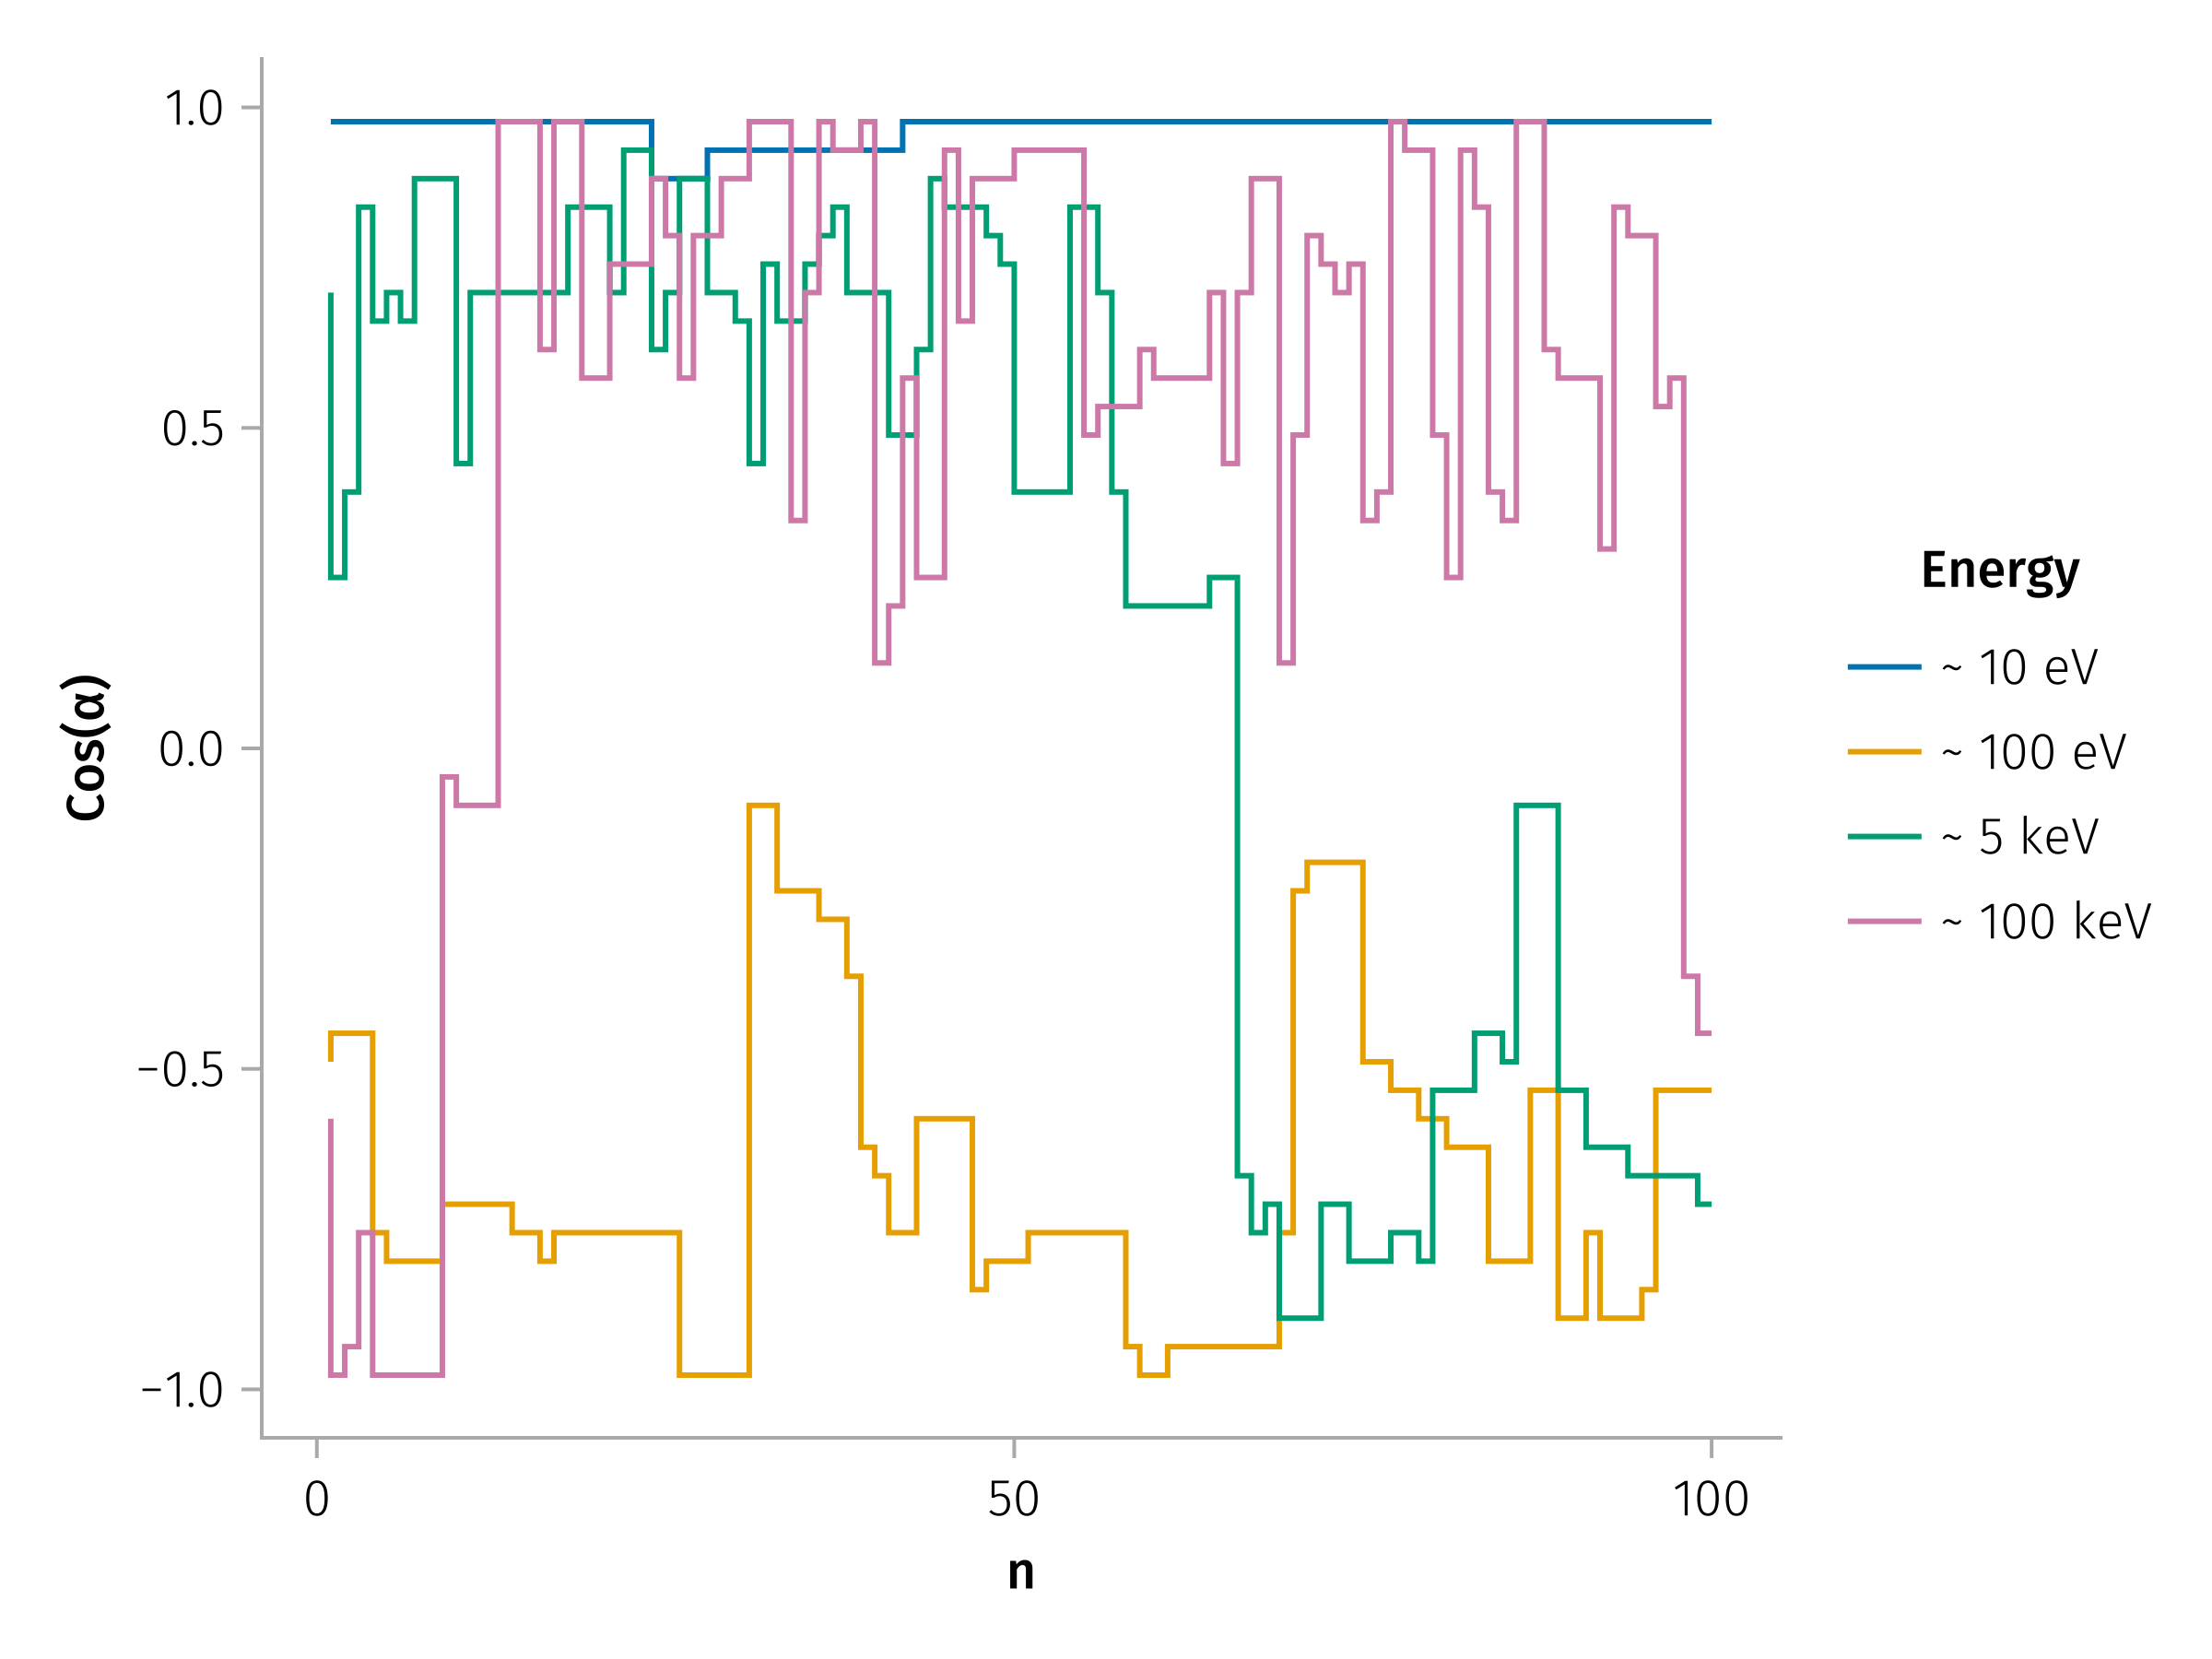

Long-Term Pitch Angle Evolution
Example of Multiple Pitch Angle Scattering for Different Energies
$$α_{n+1,i}=W\left(α_{n,i},ξ_{n,i}\right)$$
Notes:
Notes: - Rare large-angle jumps drive rapid mixing.
A key feature of the pitch-angle dynamics is the occurrence of infrequent but substantial jumps, including rare, large-angle changes that can lead to particle reflection from the current sheet.
However, directly incorporating stochastic difference equations and the WTM into classical numerical schemes for transport-diffusion equations is a complex task. To facilitate comparison with other scattering processes and allow inclusion of SWD-induced scattering effects in such models, we evaluate the effective scattering rate, $D_{nn}$. This rate acts as a global diffusion coefficient, independent of the local pitch angle, since high-energy particles frequently experience large pitch-angle jumps, leading to strong mixing. The scattering rate depends on the particle energy and the WTM (i.e., the distribution of current sheets). Using the mapping described in Equation~\ref{eq-mapping} for an ensemble of particles, we calculate the evolution of the second moment of the pitch-angle distribution for the particle energy range from 100 keV to 1 MeV for current sheets at 1 AU:

Slide 22
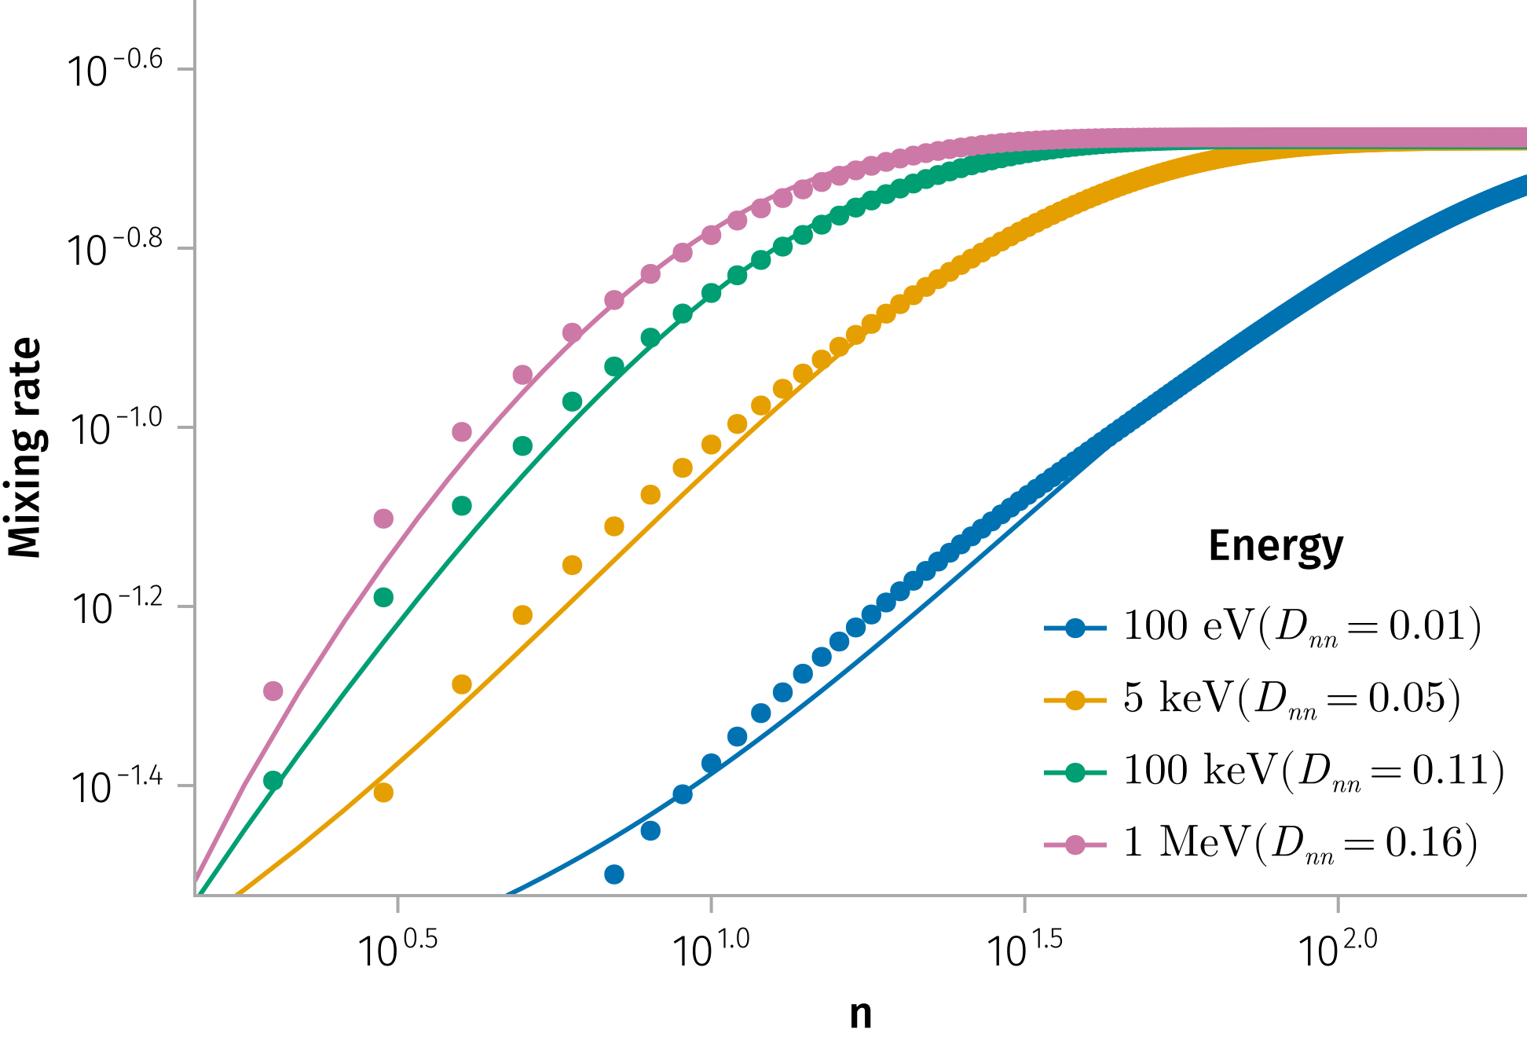
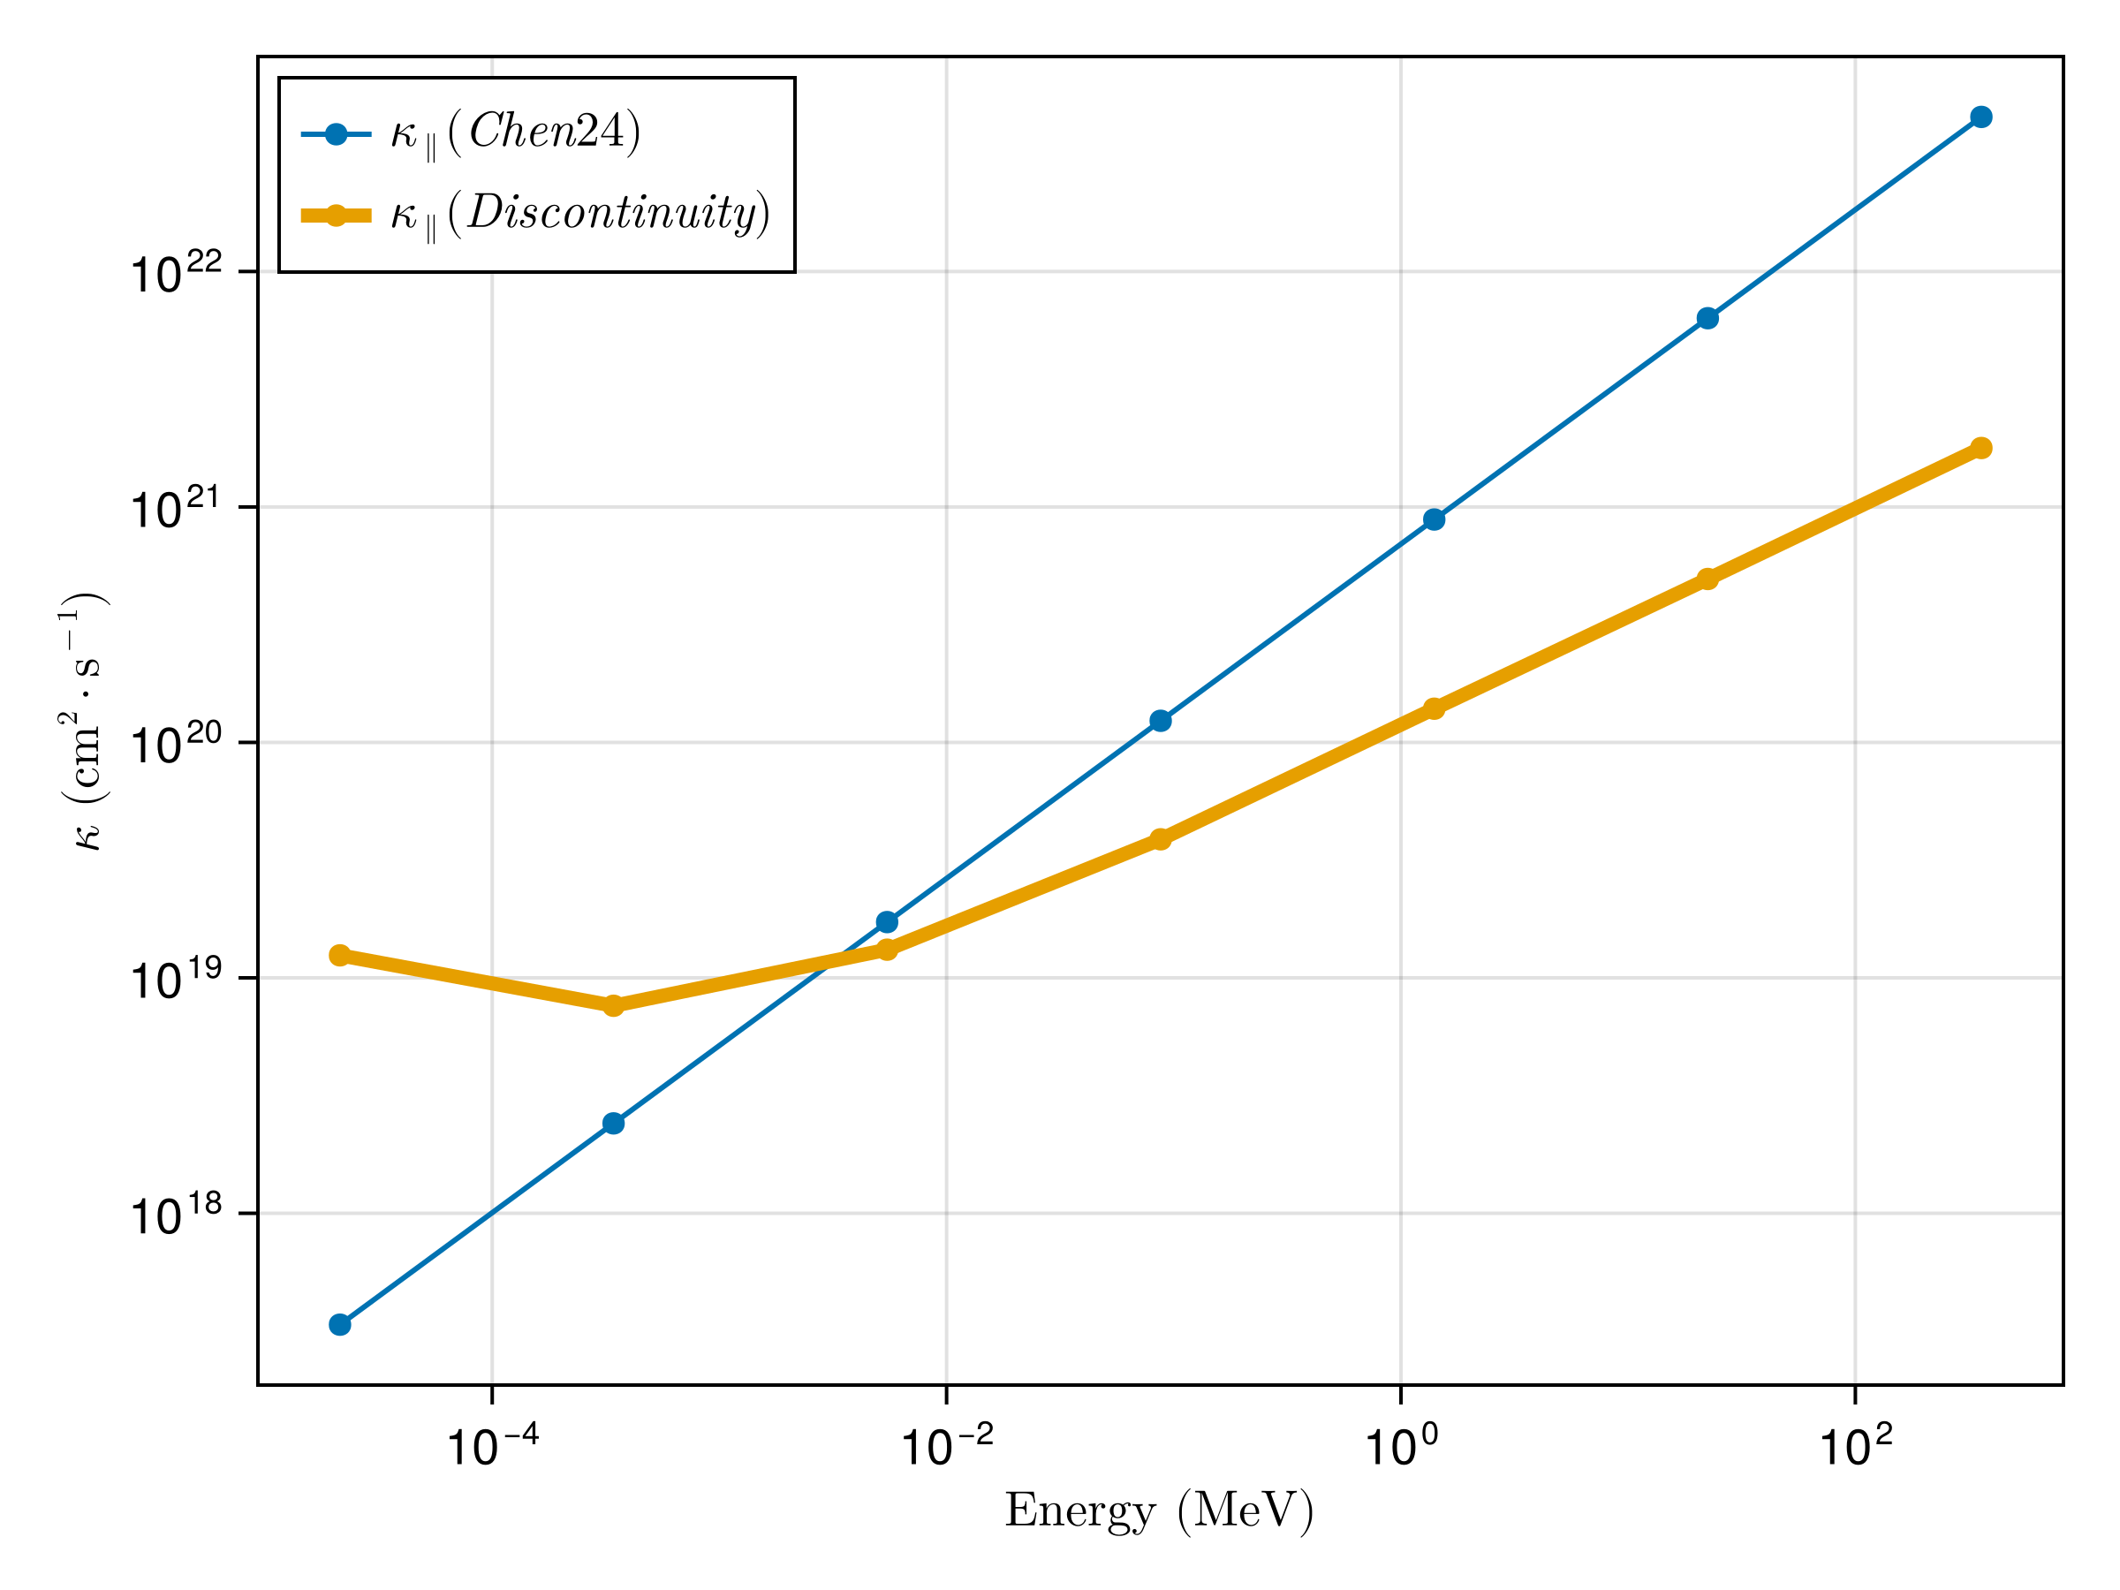
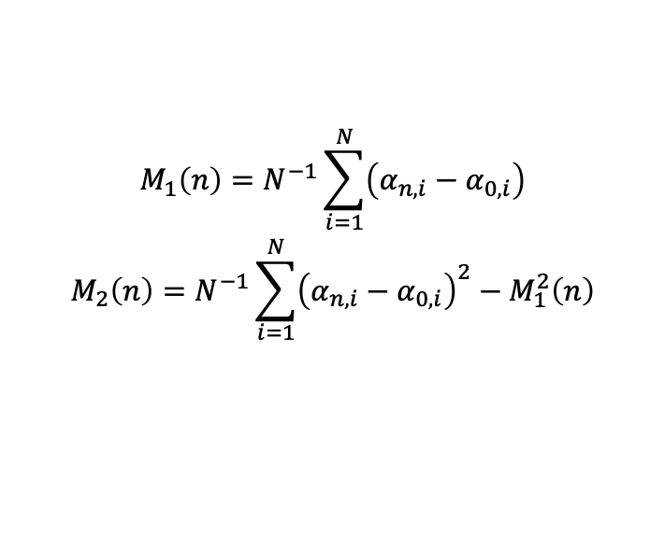
Pitch angle scattering => Parallel Diffusion
$$\begin{matrix}M_{1}\left(n\right)=N^{−1}\sum_{i=1}^{N}{\left(α_{n,i}−α_{0,i}\right)} \\ M_{2}\left(n\right)=N^{−1}\sum_{i=1}^{N}{{\left(α_{n,i}−α_{0,i}\right)}^{2}}−M_{1}^{2}\left(n\right)\end{matrix}$$
Notes:
Notes:
(D_{nn}) quantifies scattering efficiency.

Slide 23
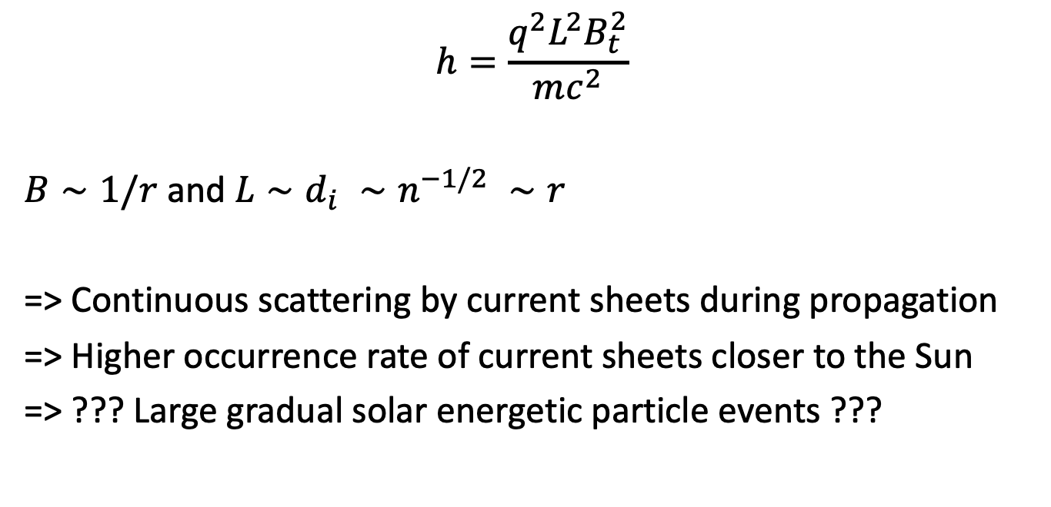
Implications for Particle Transport
$$h=\frac{q^{2}L^{2}B_{t}^{2}}{mc^{2}}$$
$B∼1/r$ and $L∼d_{i} ∼n^{−1/2} ∼r$
=> Continuous scattering by current sheets during propagation
=> Higher occurrence rate of current sheets closer to the Sun
=> ??? Large gradual solar energetic particle events ???
Notes:
Key Points:
Impact on spatial diffusion and acceleration processes.
Connection between enhanced pitch-angle scattering and reduced acceleration timescales in shocks.
Broader relevance for heliospheric and astrophysical plasma transport.
Notes:
Summarize how the research improves our understanding of energetic particle dynamics.
Emphasize the potential integration of these results into global transport models.
Image Suggestion:
Conceptual diagram linking pitch-angle scattering, spatial diffusion, and particle acceleration in shock environments.

Slide 24
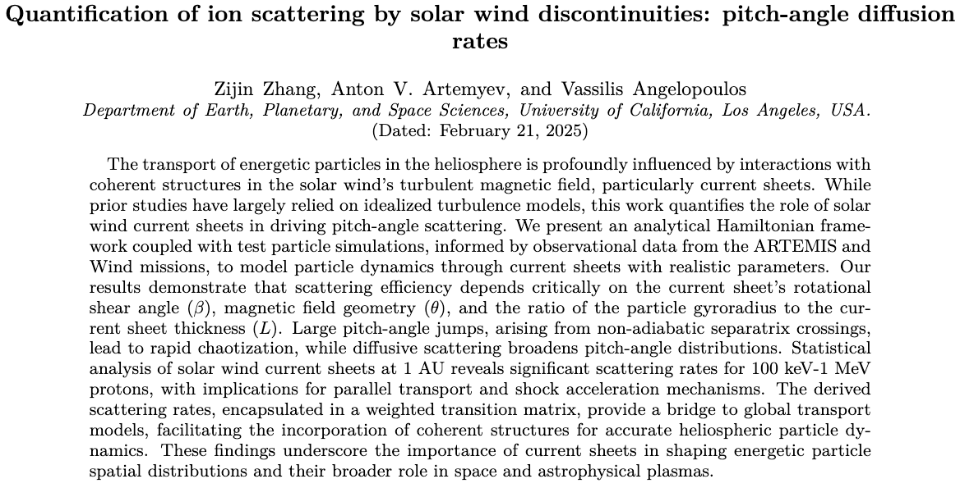
Conclusions
Notes:
Key Points:
Recap of major findings: analytical model, simulation results, and effective scattering rate.
Future directions: investigation of cross-field diffusion, model refinement, and further observational studies.
Notes:
Summarize the key contributions of the research.
Invite audience questions and provide contact information for follow-up discussions.
Image Suggestion:
A summary graphic or montage that visually encapsulates the research process and findings, with space for contact details.

Slide 25
References
Artemyev, A. V., A. I. Neishtadt, A. A. Vasiliev, V. Angelopoulos, A. A. Vinogradov, and L. M. Zelenyi. 2020. “Superfast Ion Scattering by Solar Wind Discontinuities.” Physical Review E 102 (3): 033201. https://doi.org/10.1103/PhysRevE.102.033201.
Desai, Mihir, and Joe Giacalone. 2016. “Large Gradual Solar Energetic Particle Events.” Living Reviews in Solar Physics 13 (1): 3. https://doi.org/10.1007/s41116-016-0002-5.
Giacalone, J., and J. R. Jokipii. 1999. “The Transport of Cosmic Rays Across a Turbulent Magnetic Field.” The Astrophysical Journal 520 (1): 204. https://doi.org/10.1086/307452.
Hussain, A. K. M. F. 1983. “Coherent Structures—Reality and Myth.” Physics of Fluids 26 (10): 2816–50. https://doi.org/10.1063/1.864048.
Liu, Y. Y., J. B. Cao, H. S. Fu, Z. Wang, Z. Z. Guo, and R. J. He. 2023. “Failures of Minimum Variance Analysis in Diagnosing Planar Structures in Space.” The Astrophysical Journal Supplement Series 267 (1): 13. https://doi.org/10.3847/1538-4365/acdd58.
Malara, Francesco, S. Perri, J. Giacalone, and G. Zimbardo. 2023. “Energetic Particle Dynamics in a Simplified Model of a Solar Wind Magnetic Switchback.” Astronomy & Astrophysics 677 (September): A69. https://doi.org/10.1051/0004-6361/202346990.
Malara, Francesco, Silvia Perri, and Gaetano Zimbardo. 2021. “Charged-Particle Chaotic Dynamics in Rotational Discontinuities.” Physical Review E 104 (2): 025208. https://doi.org/10.1103/PhysRevE.104.025208.
Moraal, H. 2013. “Cosmic-Ray Modulation Equations.” Space Science Reviews 176 (1): 299–319. https://doi.org/10.1007/s11214-011-9819-3.
Zelenyi, L. M., A. I. Neishtadt, A. V. Artemyev, D. L. Vainchtein, and H. V. Malova. 2013. “Quasiadiabatic Dynamics of Charged Particles in a Space Plasma.” Physics-Uspekhi 56 (4): 347. https://doi.org/10.3367/UFNe.0183.201304b.0365.

